Slide 1

The high flyers
By Harry, Carisa, Anna, and Sam

Slide 2
Rocket Jobs
Harry- The Designer
Sam- The Procedure Person
Carisa- The Time Recorder and the Calculator Person
Anna- The Folder Person

Slide 3
Scientific Method
Q:Which will go higher, water or air?
A: The water launches go higher because the water in the rocket acts as fuel for the rocket.
Q:How does the rocket launch?
A:The pressure from the air causes the rocket to shoot up.

Slide 4
Rocket Procedure
We brought in soda bottles for our launches.
We learned how to make a cone because we remembered our flash cards.
We wrapped our rocket with construction paper.
We made the fins for our rocket and we taped them on.
We put bubble wrap inside the cone for our egg to survive .
We put commander eggy inside the cone and taped it down.
We got our timers and we went outside for the air launches!
We made the fins into cardboard instead of paper.
We finally launched with water and air.

Slide 5
Materials Used
Soda bottle
Cardboard
Construction paper
Bubble wrap
One egg

Slide 6
Prediction/Hypothesis
Our prediction was that the water and air rockets would go higher because the water inside the rocket would act as fuel but the air rockets only had the pressure of the air. The water and air combined would make the rocket go higher.

Slide 7
Data Chart

Slide 8
Compare/Contrast
The things that were the same about both launches is that in both, the eggstronaut survived. We used 80 psi for both launches. Every groups water and air eggstronaut survived. The differences between the two launches is that our groups rockets were build differently each time we launched. The water and air launch for our group went higher than the air launches.

Slide 9
Conclusion
Both launches were different because the water launch rockets all went higher than the air rockets. They all went higher because the air launches didn`t have as much power. Our groups eggstronaut survived both launches. Our egg survived because we put a lot of padding and bubble wrap. What we could have done differently is that we could have put more bubble wrap inside the capsule to make sure that the eggstronaut would not crack.

Slide 10

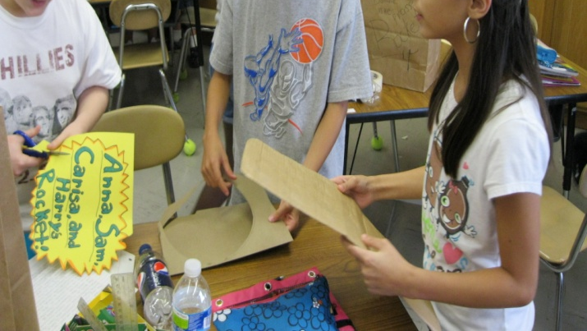

Slide 12
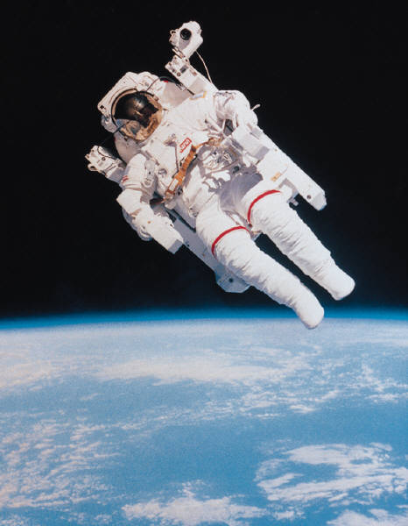

Slide 14


